Slide 1
Metagenomics Bioinformatics Applications (PLPTH813)
Sanzhen Liu
4/16/2019

Slide 2
Outline
Introduction of metagenomics
Marker gene analysis (rRNA)
Whole genome analysis
Metatranscriptome analysis

Slide 3
What is metagenomics?

Slide 4
Terms
metagenomics: The application of high-throughput DNA sequencing to profile the genomic composition of a microbial community in a culture-independent manner.
microbiomes: The community composition, biomolecular repertoire and ecology of microorganisms inhabiting particular environments.
microbiota: The collection of microorganisms (of all types: bacteria, archaea, viruses and eukaryotes) inhabiting a particular environment.

Slide 5
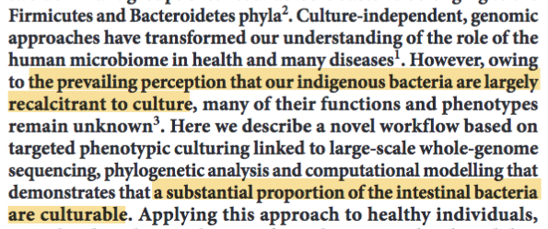
metagenomics
Advances in DNA sequencing have enabled culture-independent profiling of microbial community membership and function - the field of metagenomics. (e.g., a study indicated that cultivation methods found <1% of the bacterial & archaeal species in samples.)
HP Browne, et al. Nature 533:543–546 (2016)

Slide 6
Approaches
Marker gene analysis
Whole genome analysis
Metatranscriptome analysis

Slide 7
Marker gene analysis
Marker gene sequencing uses primers that target a specific region of interest to determine microbial community of a sample.
variable region
conserved
conserved
fast
low-cost
low-resolution
Limited information

Slide 8
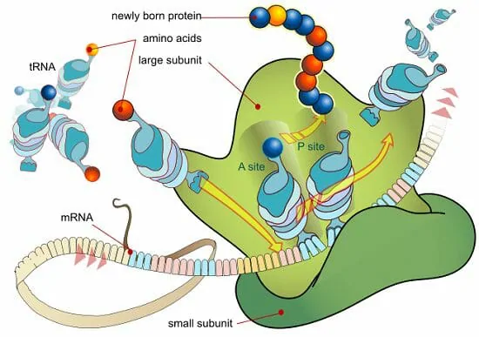
ribosomal RNA
Conserved sequences within a species
Generally divergent between species
Relative short (e.g., 1.5kb 16S rRNA gene)
biologydictionary.net/ribosomal-rna/
Ribosomal RNA | Eukaryotic | Bacterial
Large subunit | 28S rRNA (3354 nt) | 23S rRNA (2839 nt)
 | 5S rRNA (120 nt) | 5S rRNA (122 nt)
 | 5.8S rRNA (154 nt)
 | 47 proteins | 33 proteins
Small subunit | 18S rRNA (1753 nt) | 16S rRNA (1504 nt)
 | 32 proteins | 20 proteins

Slide 9
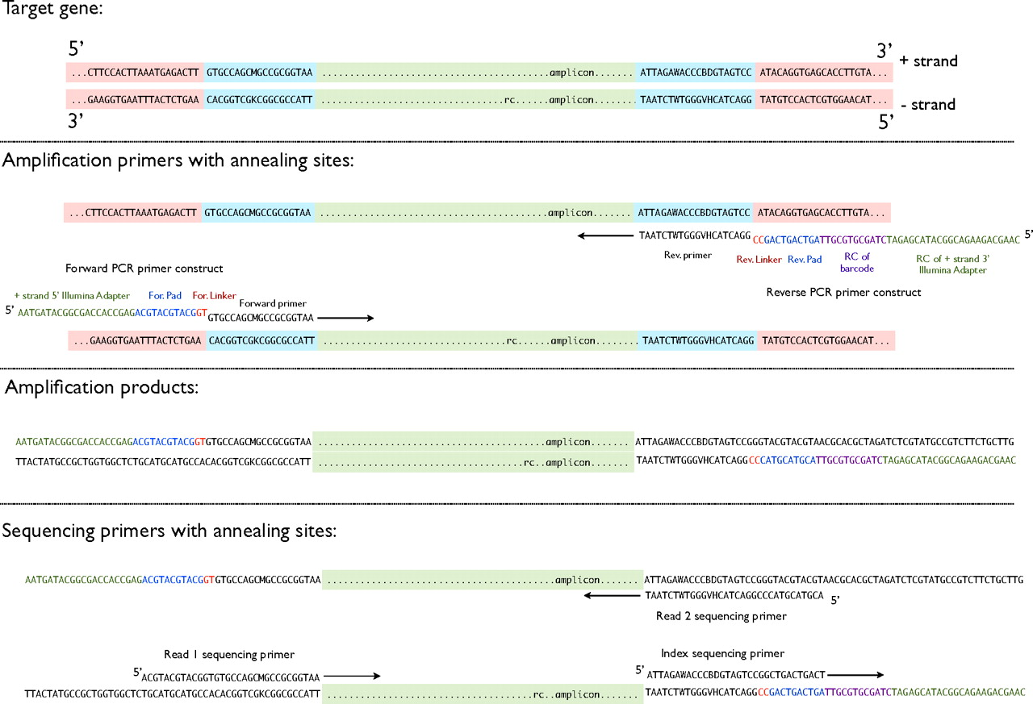
16S rRNA sequencing
PNAS, 108:4516–4522 (2011)

Slide 10
QIIME
Quality filtering of reads
OTU (operational taxonomic unit ) picking:
de novo: : all-to-all alignments and clustering
closed-reference: OTU aligned to pre-defined cluster centroids in a reference database. OTU excluded if no matches
open-reference: aligned to the reference & de novo
Output:
OTU table or the number of times each OTU is observed in each sample.
Notes:
and Mothur

Slide 11
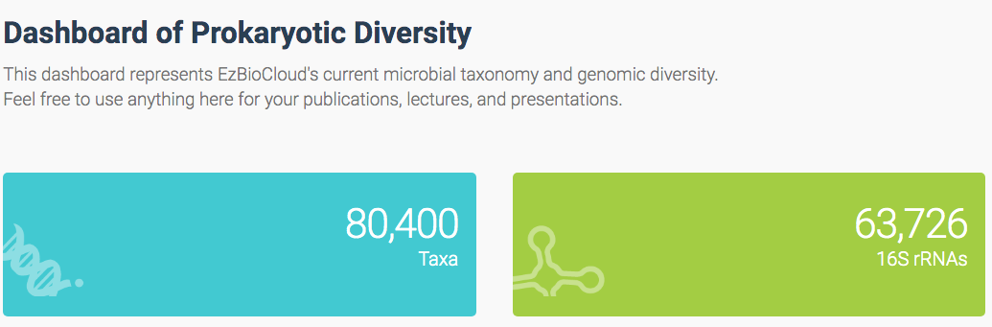
16s rRNA (bacteria)
16S rRNA database: the Ribosomal Database Project, Greengenes, SILVA, EzTaxon
ezbiocloud database (www.ezbiocloud.net)
bacteria: 60,883
archaea: 2,843
taxonomic classification: to assign taxonomic names to microbial sequences in the data

Slide 12
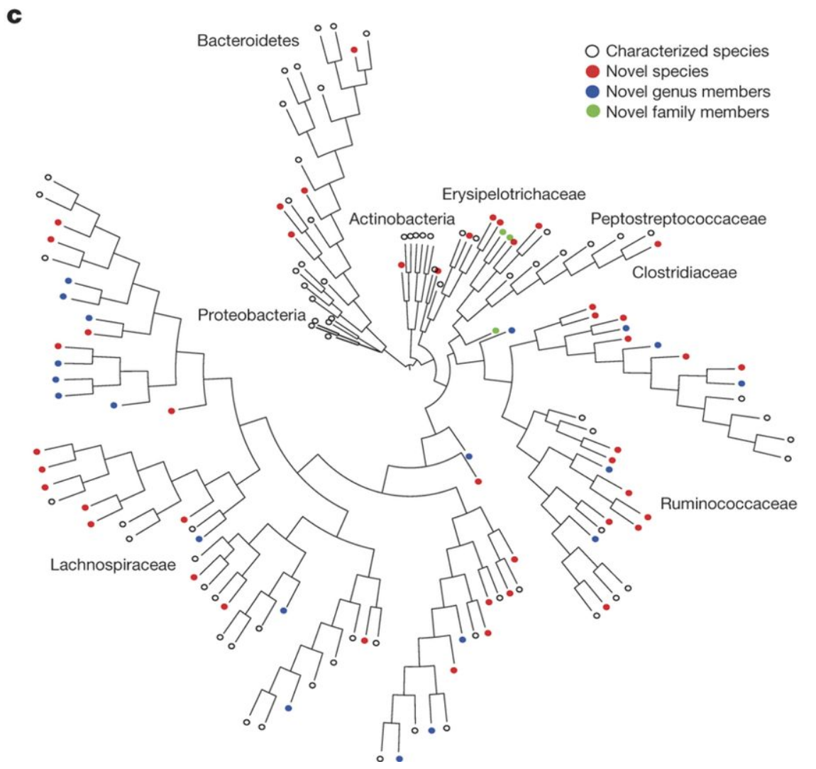
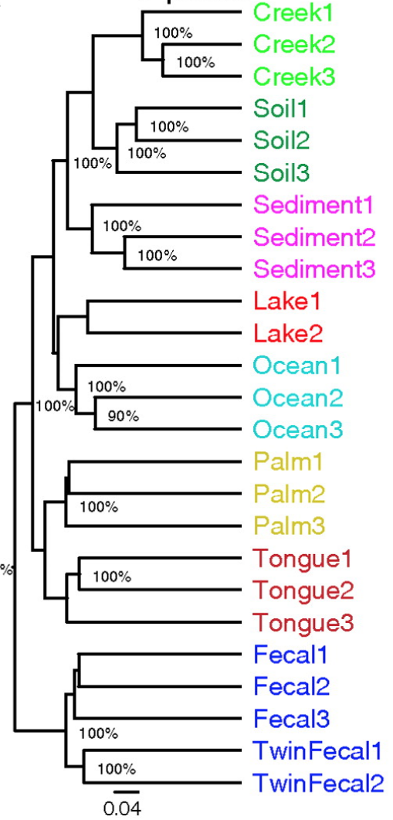
Microbial communities
From one sample
From diverse samples

Slide 13
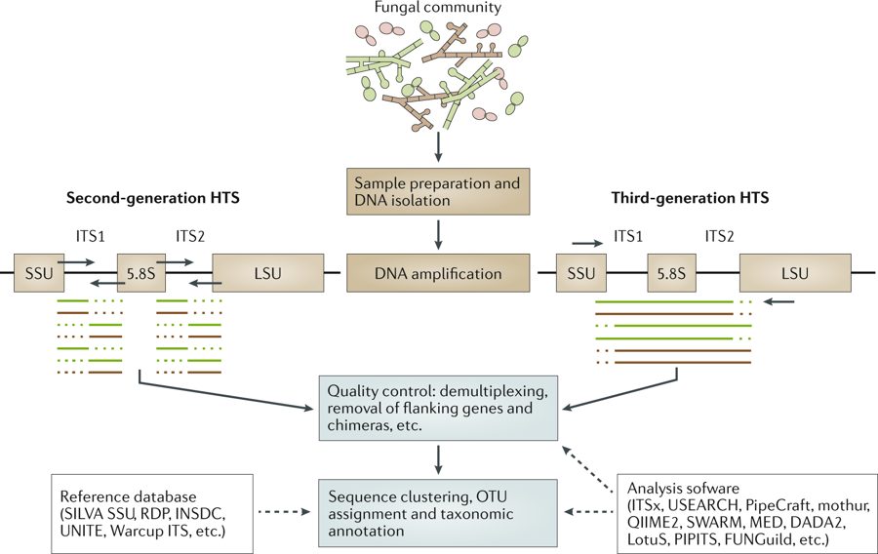
ribosome DNA (fungal example)
rRNA | Eukaryotic
Large subunit | 28S rRNA (3354 nt)
 | 5S rRNA (120 nt)
 | 5.8S rRNA (154 nt)
 | 47 proteins
Small subunit | 18S rRNA (1753 nt)
 | 32 proteins
RH Nilsson et al. Nat Rev Microbiol 17:95–109 (2019)
Notes:
operational taxonomic unit (OTU)

Slide 14
Tools for marker gene analysis
Name | Description and link
DADA2 | Amplicon sequence variant analysis pipeline
LotuS | Full pipeline for amplicon data
mothur | Versatile software suite (designed mostly for 16S rRNA)
AMPtk | Full pipeline for amplicon data
OBITools | Versatile software package
PipeCraft | Full pipeline for amplicon data (with graphical user interface)
PIPITS | Full pipeline for fungal ITS amplicon data (only for Illumina data)
QIIME | Full pipeline for amplicon data (designed mostly for 16S rRNA)
SEED2 | Full pipeline for amplicon data (with graphical user interface; on Windows)
Microbiology.se | Tools, including ITSx and Metaxa2, for processing ITS, SSU and LSU data
USEARCH | Versatile software package
VSEARCH | Versatile software package

Slide 15
Whole-metagenome analysis
Sequencing of "all" DNA, including viral and eukaryotic DNA.
High taxonomic resolution: to species or strain levels
Assembly of whole microbial genomes
Relatively expensive

Slide 16
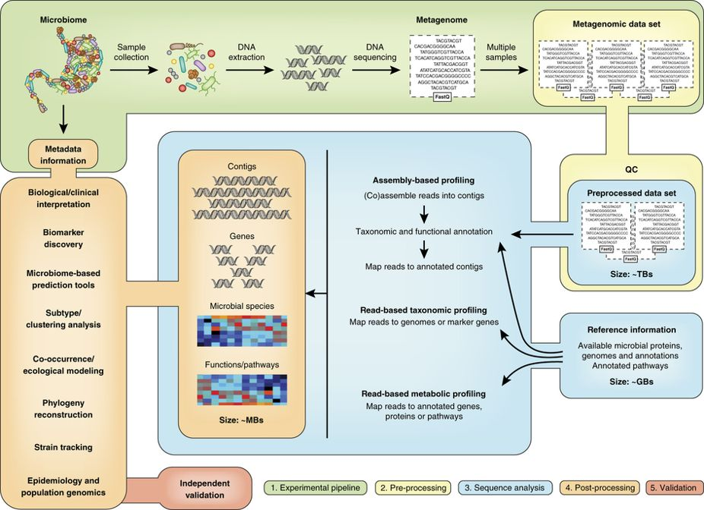
Assembly-based
Read-based

Slide 17
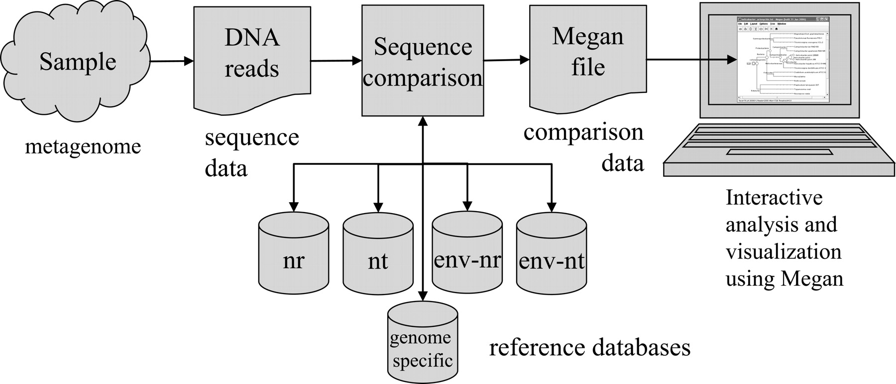
Read-based analysis (Megan)
Genome Res, 17:377-86 (2007)
DNA sequences were aligned against databases of known sequences (e.g., BLAST). MEGAN then assigns taxonomy and summaries the results.

Slide 18
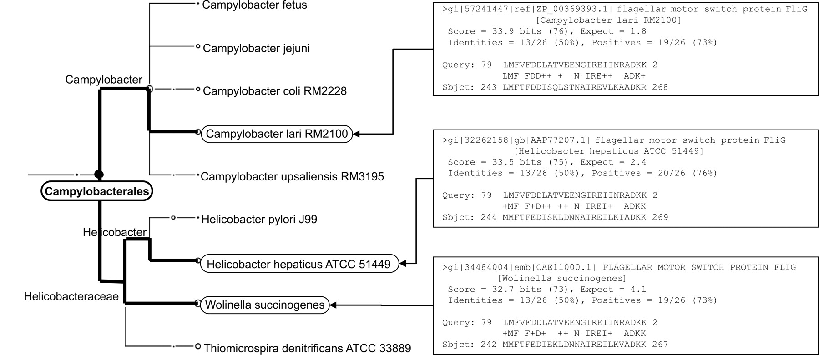
LCA: lowest common ancestor
✔
A simple LCA algorithm assigns reads to taxa
(e.g., the read was assigned to Campylobacterales)

Slide 19
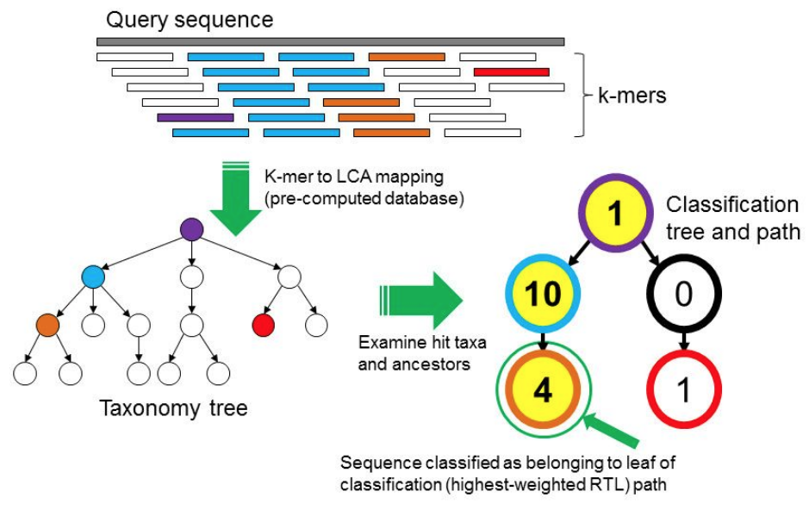
Read-based analysis (Kraken: k-mer analysis)
simple
fast (exact match)
Genome Biology, 15:R46 (2014)
Kraken has a database that contains records consisting of a k-mer and the LCA of all organisms whose genomes contain that k-mer.
Notes:
The Kraken sequence classification algorithm. To classify a sequence, each k-mer in the sequence is mapped to the lowest common ancestor (LCA) of the genomes that contain that k-mer in a database. The taxa associated with the sequence’s k-mers, as well as the taxa’s ancestors, form a pruned subtree of the general taxonomy tree, which is used for classification. In the classification tree, each node has a weight equal to the number of k-mers in the sequence associated with the node’s taxon. Each root-to-leaf (RTL) path in the classification tree is scored by adding all weights in the path, and the maximal RTL path in the classification tree is the classification path (nodes highlighted in yellow). The leaf of this classification path (the orange, leftmost leaf in the classification tree) is the classification used for the query sequence.

Slide 20
Assembly-based analysis
Metagenome de novo assembly is conceptually similar to whole-genome assembly (de Bruijn graph).
Challenges:
1. Typically a number of species
2. Uneven sequencing coverage of each genome
3. Multiple strains from a species
Resulting in fragmented assemblies (e.g., million of contigs)
metagenomic assemblers: MEGAHIT and metaSPAdes

Slide 21
Contig binning: to group contigs into species
Number of genomes and what genomes (species)
Taxonomic classification: contig aligned against known genomes
Sequence composition is used for binning contigs from unknown genomes
Genomes have particular combinations of bases (tetramers)
Sequencing coverage: sequences from the same genome have similar sequencing depth
Contigs are reconstructed into metagenomic assembled genomes (MAGs)

Slide 22
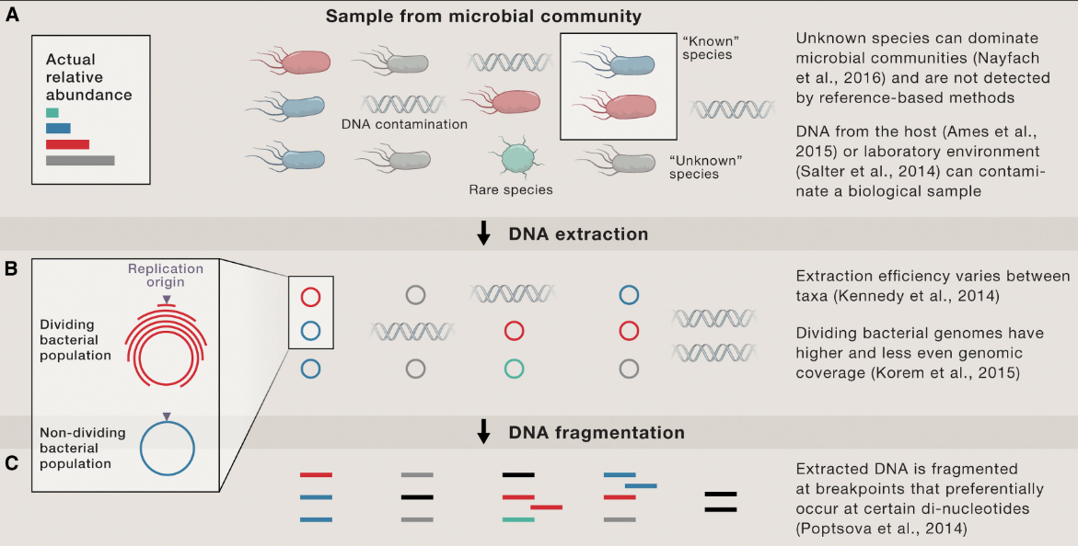
Example of bacterial whole-genome metagenomics (I)
S Nayfach et al., Cell, 166:1103-1116 (2016)
Notes:
low biomass samples; contaminated DNA will be introduced by overamplification.

Slide 23
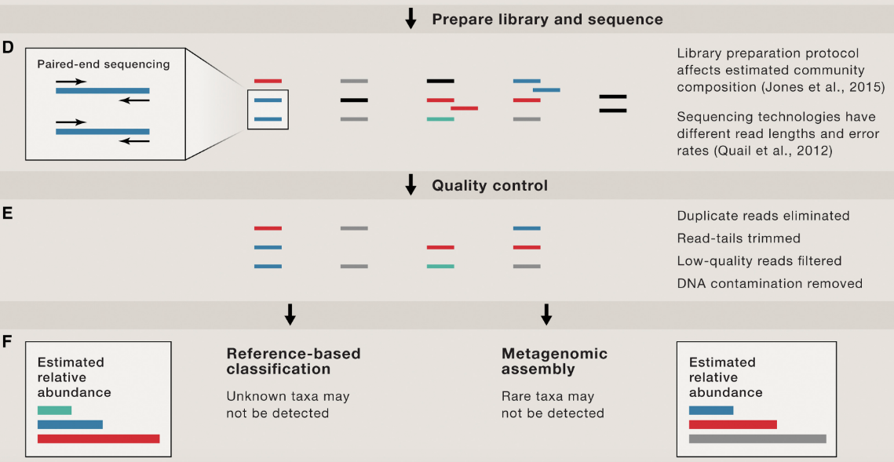
Example of bacterial whole-genome metagenomics (II)
S Nayfach et al., Cell, 166:1103-1116 (2016)

Slide 24
Metatranscriptome
Metatranscriptomics uses RNA sequencing to profile transcription in microbiomes, providing information on active functional outputs of the microbiome.
To acquire high-quality RNA might be challenging (e.g., feces)
rRNA contamination

Slide 25
Metatranscriptome analysis
mRNA or gene expression is the focus
rRNA removal during library prep but not complete
Generally, the following reads are discarded:
non-mRNA reads
reads derived from hosts
RNA-Seq analyzing tools for assembly and differential expression are useful for metatranscriptome analysis.

Slide 26
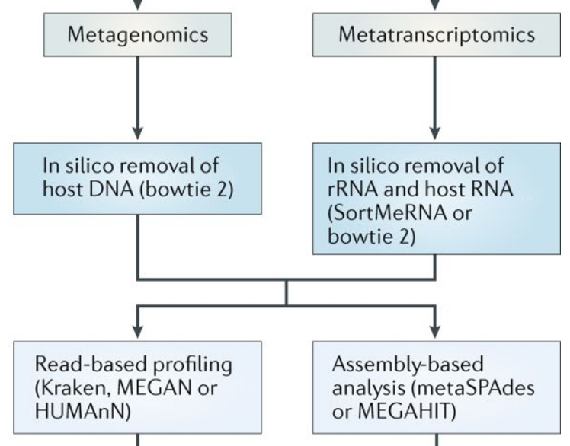
Metagenome and metatranscriptome analysis

Slide 27
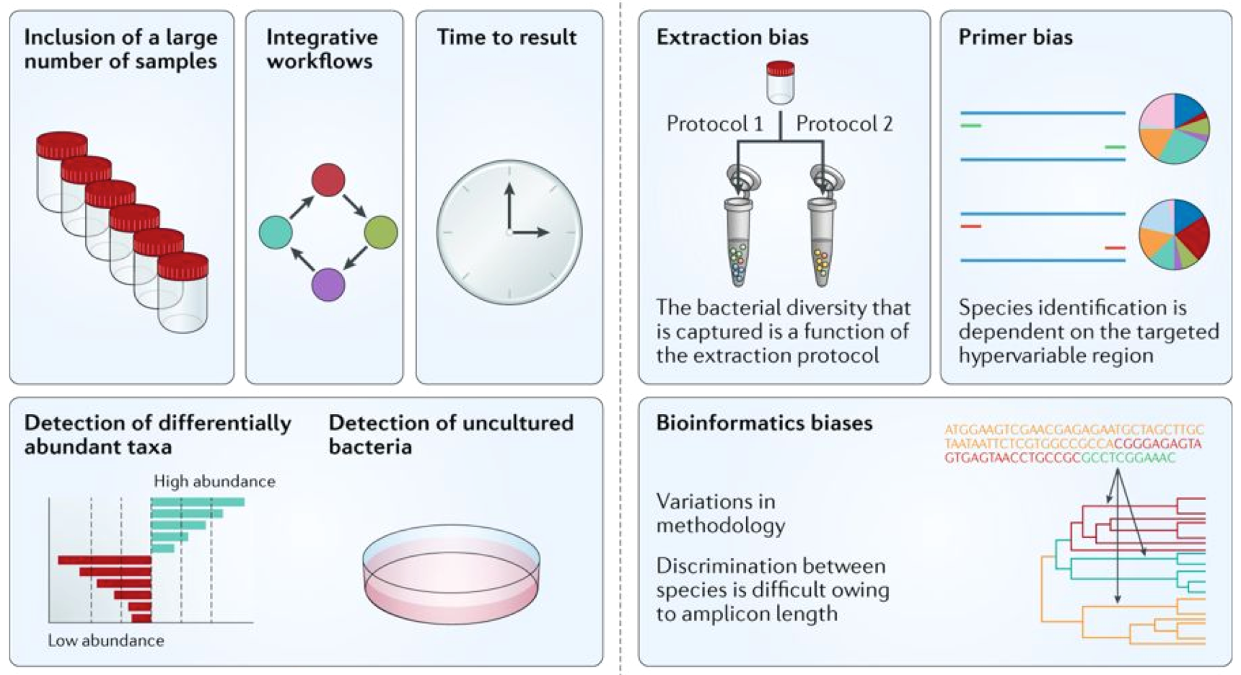
Strengths and weaknesses of metagenomic studies
Strengths
Weaknesses
Notes:
High-throughput sequencing methods have enabled comparisons of large cohorts in record time, as the time it takes to generate results has substantially decreased over the past decade owing to integrative workflows. Sequencing enables uncultured bacteria to be identified and associates microbial signatures with a particular physiological state or disease as the relative abundance of each taxon can be measured. In addition, bacterial species can be grouped without taxonomic assignment. Shotgun sequencing enables the function of microbial communities to be inferred through the analysis of genomes and the coding potential. However, these methods are limited by the heterogeneity of the protocols used. Discrepant results can be obtained depending on the method used to extract DNA or the primers that are used for amplification. The variety of methodologies proposed for bioinformatics analyses (for example, operational taxonomic unit clustering, taxonomic assignment or statistical analysis) can substantially affect the results. Sequencing methods cannot discriminate between live bacteria and transient DNA, and despite recent progress, they cannot easily detect minority populations (for example, bacteria that are present at <105 cells per gram of faeces).

Slide 28
biases (cont.)
Technical biases from DNA extraction, primers, PCR, and sequencing procedure
Index (barcode) or template switching: chimeric products during PCR
solution: less PCR cycles and chimaera filtering?
Clustering Issue: satellite OTUs introduced by sequencing errors could lead to the overestimation of richness of the microbial community.
solution: removal of rare OTUs and multiple rounds of clustering

Slide 29
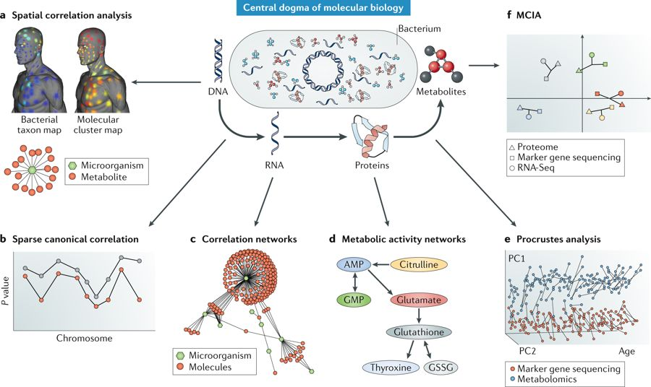
High-level analyses

Slide 30
References
Caporaso, J. G. et al. Global patterns of 16S rRNA diversity at a depth of millions of sequences per sample. Proc. Natl. Acad. Sci. U. S. A. 108, 4516–4522 (2011).
Browne, H. P. et al. Culturing of ‘unculturable’ human microbiota reveals novel taxa and extensive sporulation. Nature 533, 543–546 (2016).
Nayfach, S. & Pollard, K. S. Toward Accurate and Quantitative Comparative Metagenomics. Cell 166, 1103–1116 (2016).
Knight, R. et al. Best practices for analysing microbiomes. Nat. Rev. Microbiol. 16, 410–422 (2018).
Nilsson, R. H. et al. Mycobiome diversity: high-throughput sequencing and identification of fungi. Nat. Rev. Microbiol. 17, 95–109 (2019).
Riesenfeld, C. S., Schloss, P. D. & Handelsman, J. Metagenomics: genomic analysis of microbial communities. Annu. Rev. Genet. 38, 525–552 (2004).
Bashiardes, S., Zilberman-Schapira, G. & Elinav, E. Use of Metatranscriptomics in Microbiome Research. Bioinform. Biol. Insights 10, 19–25 (2016).
Huson, D. H., Auch, A. F., Qi, J. & Schuster, S. C. MEGAN analysis of metagenomic data. doi:10.1101/gr.5969107

